Slide 1
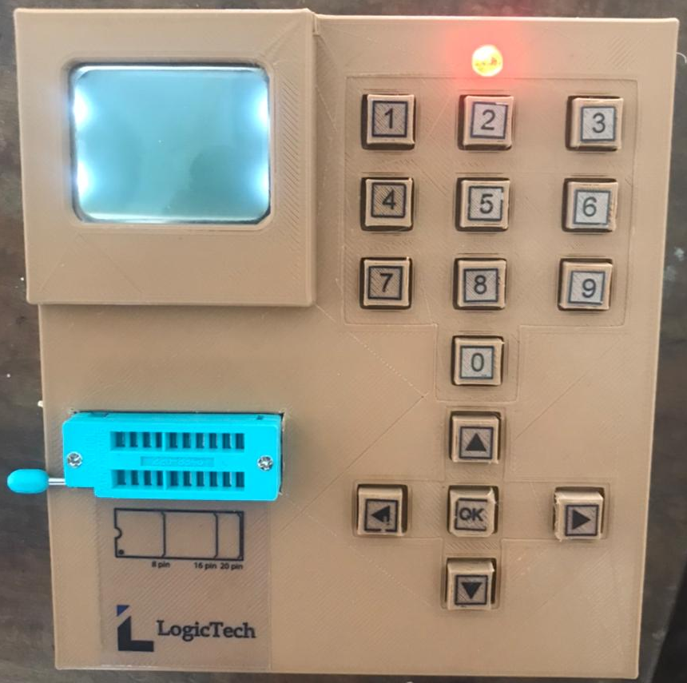

DIGITAL IC TESTER
GROUP 13

Slide 2


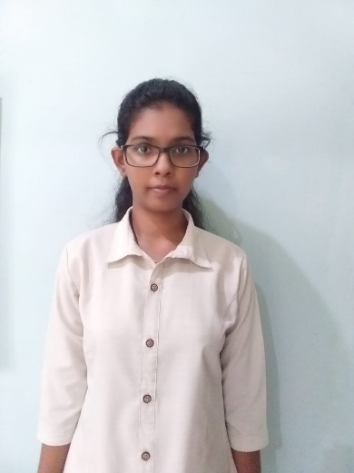

GROUP MEMBERS
E.M. DEWMINA
E/18/071
S.T.C. DHARMASIRI
E/18/078
W.M.V.S. HERATH
E/18/134

Slide 3
Problem Statement
Efficiently identifying and resolving issues within integrated circuits (ICs) during circuit work requires a user-friendly and cost-effective solution to streamline testing and confidently explore IC functionality with ease and accuracy.

Slide 4
Introducing… DIGITAL IC TESTER
Key Features:
Low cost
Accurate results
Portability
User friendly
Ability to upgrade firmware

Slide 5
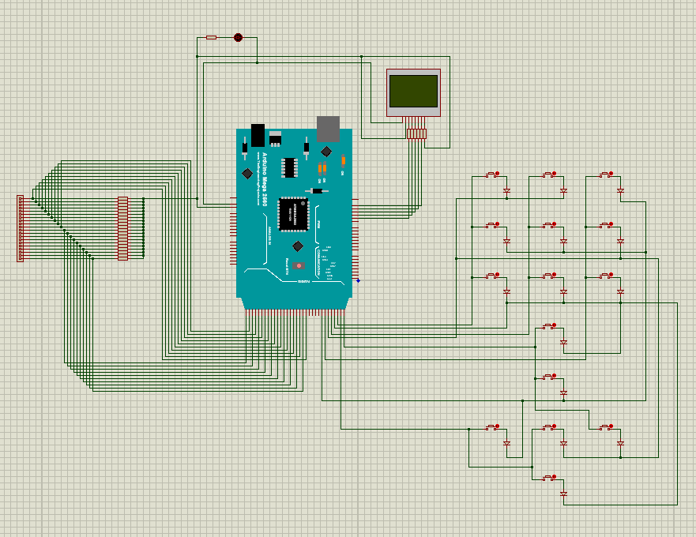
Circuit Diagram

Slide 6
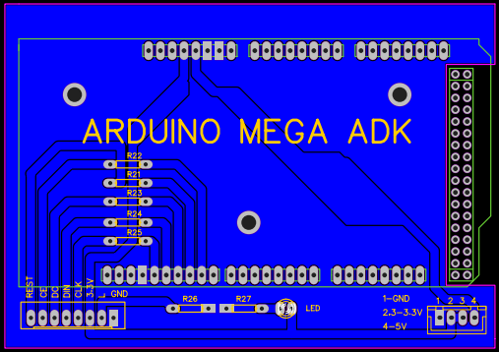
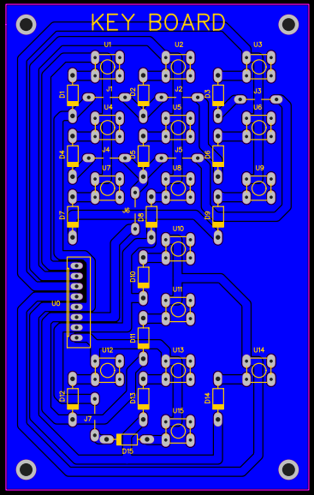
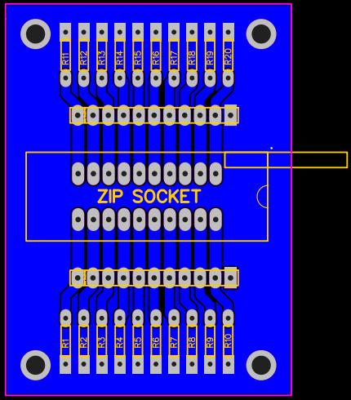
PCB DESIGN

Slide 7
Testable ICs on our device
Manual supported ICs: 4011, 4030, 4077, 4093, 4071, 4081, 4001, 4070, 7266, 7402, 7401, 4073, 4075, 4023, 4025, 7411, 5411, 7410, 7412, 7427, 4069, 7404, 7405, 7414, 7400, 74132,7403, 7408, 7432, 7486, 5408, 5479, 7409, 5409, 4029, 4000, 74393, 7421, 5421, 7420, 4082, 4012, 4002, 4072, 7430, 4068, 4049, 4050, 7474, 7476, 7479,7478,7473
Auto supported ICs: 4081, 4001, 4070, 4030, 7266, 4077, 4071, 7401, 7402, 4011, 4093, 4073, 4075, 4023, 4025, 7411, 5411, 7410, 7412, 7427, 4029, 74393

Slide 8
Thank you
Questions?

Slide 9
Key Features
Low cost
Accurate results
Portability
User friendly
Ability to upgrade firmware

Slide 10
Key Components used
Arduino Mega 2560
Nokia LCD 5110
20 pin ZIP socket

Slide 11
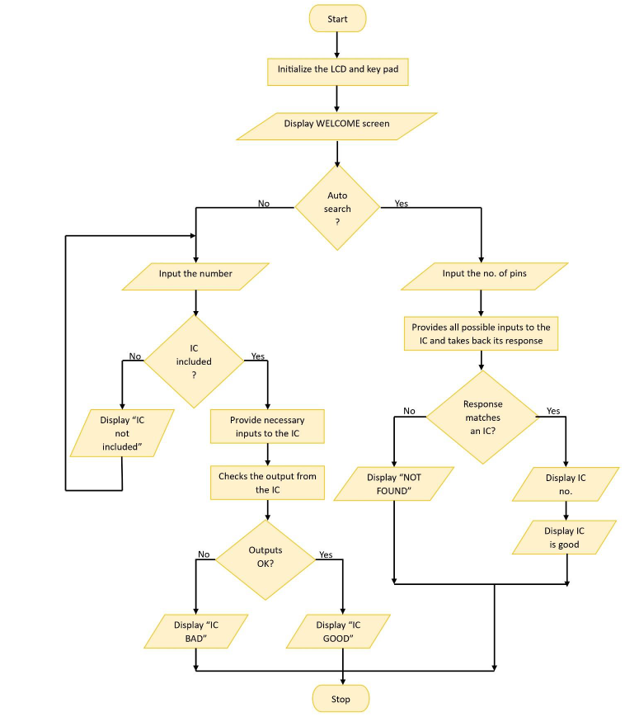
Methodology

Slide 12
Milestones
Design the circuit diagram
Implement the circuit
Design the PCB and Enclosure
Design the user manuals
Finalize the product

